Slide 1
Project - Book Reselling Application
Spring 2022 – CPSC 6210 – Scripting Languages
Lakshmi Urjitha Dhadigam – 1223270
Sai Naga Jyothi Yatagiri – 1244135

Slide 2
Introduction
The project is titled as Book Reselling Application which acts as a portal for the books’ resale.
In this application, ‘BooksData.csv’ file is created, and the data will be stored into the .csv file which will be used as database that stores the information.
The GUI allows the user (seller) to resell the books by entering the mandatory information such as book name, publishing year, author, expected price.
User can load the data, update the data, save the data into the .csv file. GUI will be designed using labels, textboxes, buttons, and message box.

Slide 3
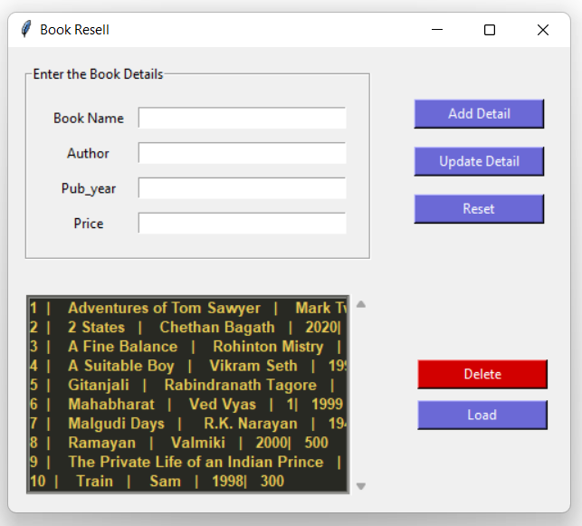
Graphical User Interface Design (GUI)
A GUI containing book name, publishing year, author, expected price will be displayed along with ‘Update Detail’ and ‘Add Detail’ buttons.
After making necessary changes, the ‘BooksData.csv’ file will be loaded with the updated data using ‘Load’ button.
To delete any record, ‘Delete’ button is also provided.

Slide 4
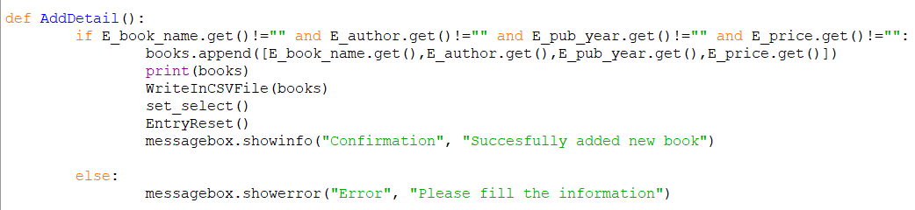
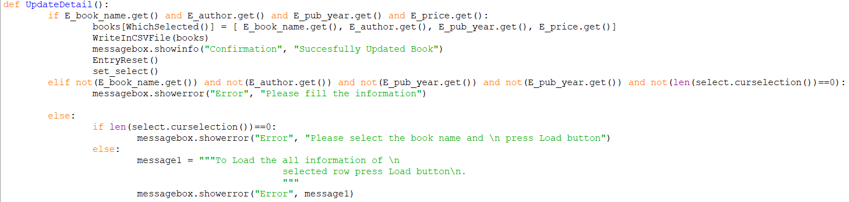
Modules

Slide 5
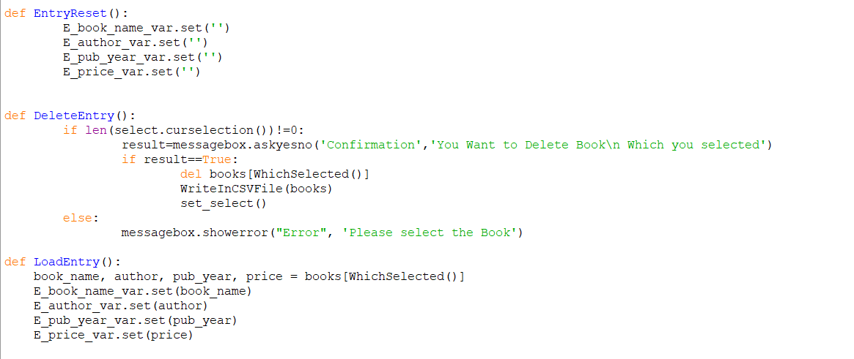

Slide 6
Summary
The project is called Book Reselling Application, and it serves as a portal for the resale of books.
The 'BooksData.csv' file is developed in this application, and the data is saved into the.csv file, which will be used as a database to hold the information.
The graphical user interface (GUI) enables the user to resell books by inputting required information such as book title, publishing year, author, and estimated price.
The user can load data, change data, and save data to .csv file. Labels, textboxes, buttons, and a message box will be used to create the GUI.
A graphical user interface (GUI) with the book title, publishing year, author, and estimated price, as well as 'Update Detail', 'Add Detail',’Delete’, ‘Reset’, ‘Load’ buttons, will be presented.
After making the appropriate modifications, the revised data will be loaded into the 'BooksData.csv' file.

